Slide 1
Data insights
Data science final test : Sondos Khaled

Slide 2
Insights about:
Product group
Category
Gender
Country
Sizes
Main color
Secondary color
Style
Retail week, month and year
promotions

Slide 3
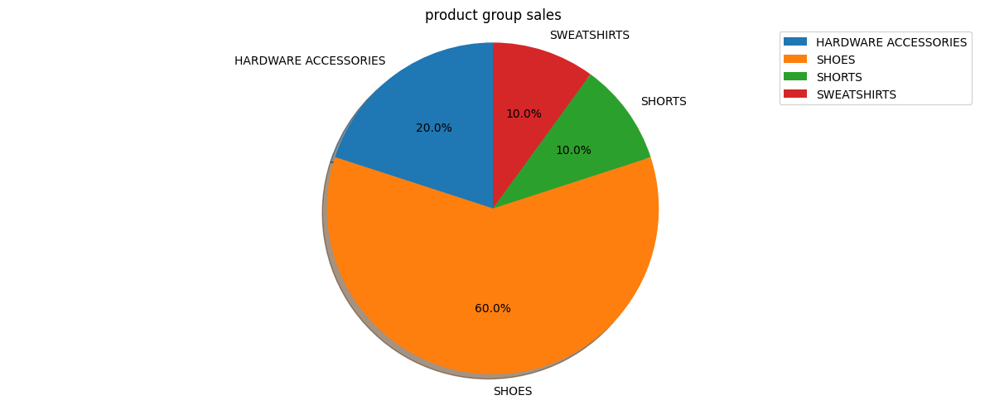
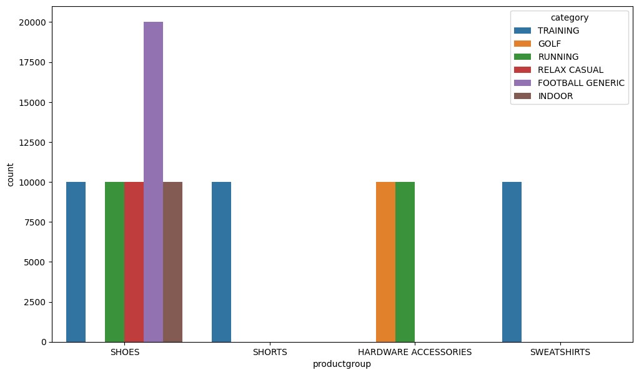
Product Group Insights
Shoes has the highest sales rate among all products.
Football generic is the dominant category in shoes products.
All categories except for football have the same ratio in shoes products.
Training is the only category in both shorts and sweatshirts products.
Golf category only exists in the hardware accessories products.
Running category only exists in hardware accessories and shoes products.

Slide 4
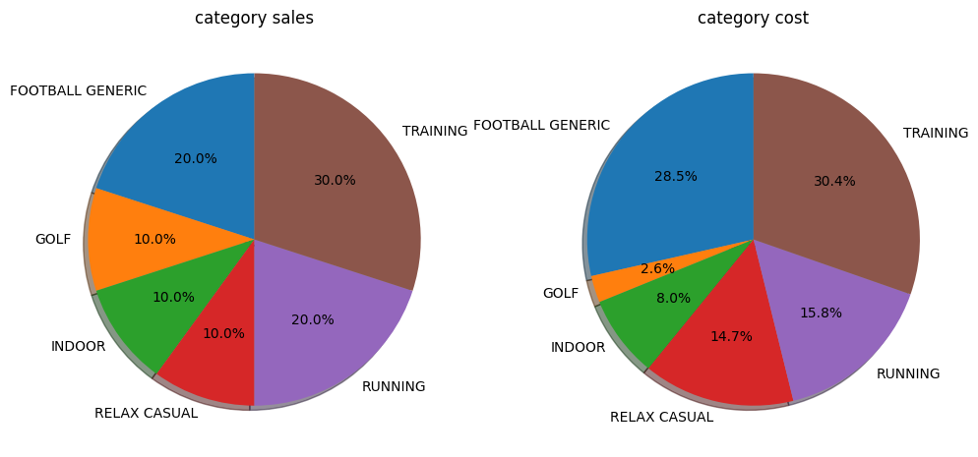
Category Insights
Training category has the highest purchase rate among all categories.
Golf, Relax Casual, and Indoor categories have the lowest purchase rate.
Training and football categories have the highest cost .
Golf category has the lowest cost.

Slide 5
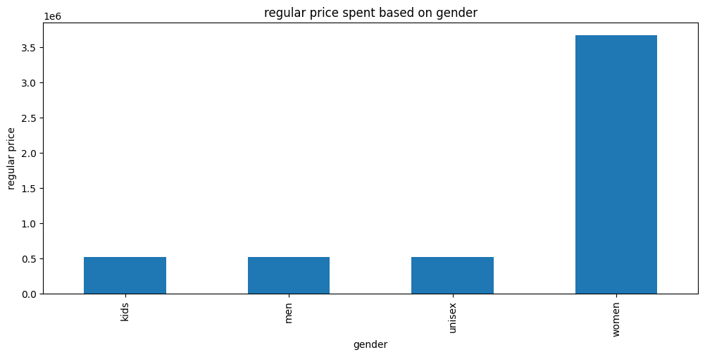
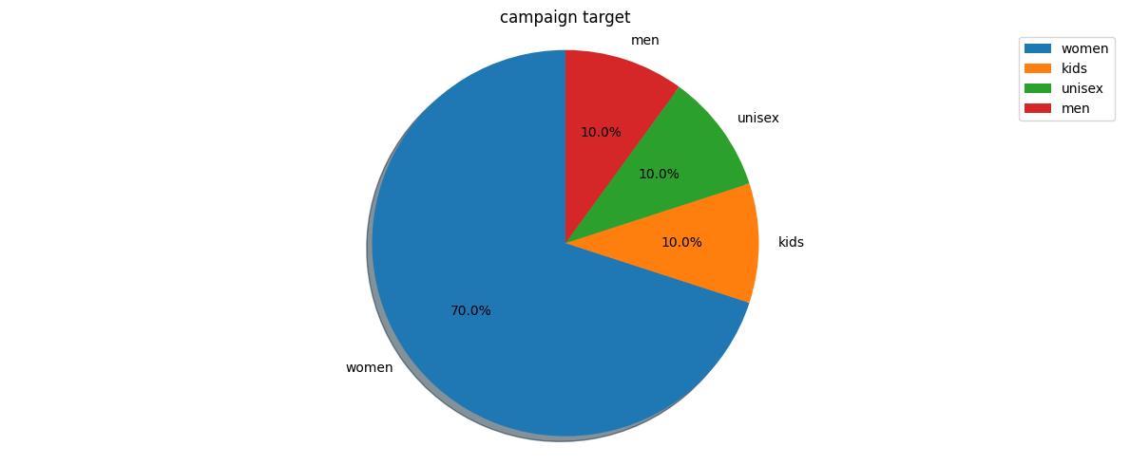
Gender Insights
Women's purchasing power is greater than the rest of the genders purchasing power
About 70% of the customers have made sales of women
Women have made sales worth more than 3 million
women are the most targeted gender of the campaign
kids, men and unisex have the same ratio of being a target and the same purchase rate

Slide 6
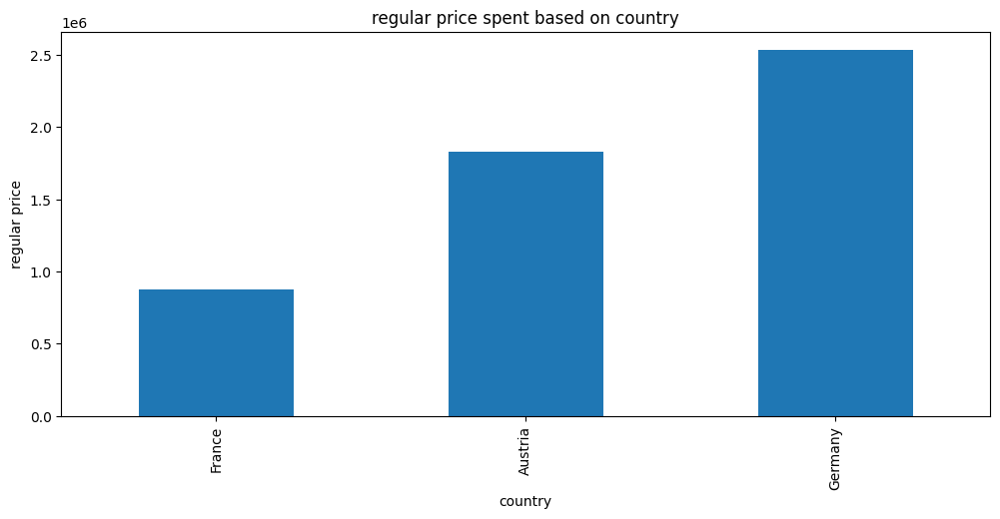
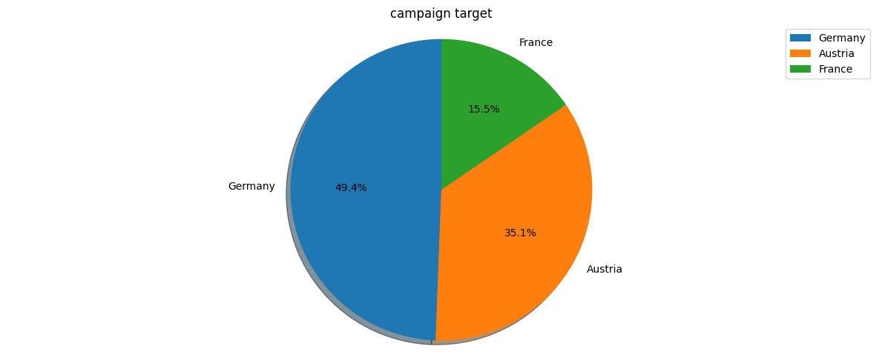
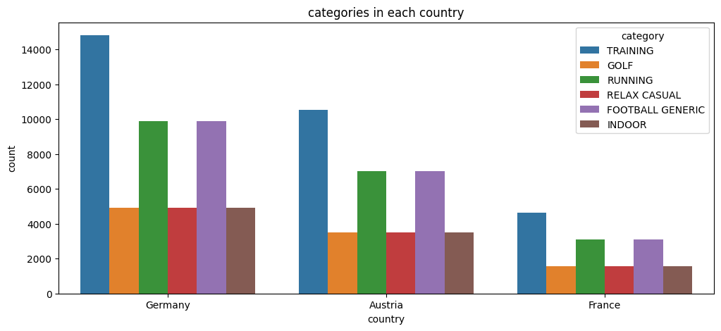
Country Insights
Germany has the highest purchase rate among all countries.
France has the lowest purchase rate.
Germany is the most targeted country in the campaign.
France is the least targeted country.
Categories has the same distribution among all countries.
4-All countries are more interested in the Training category compared to other categories.

Slide 7
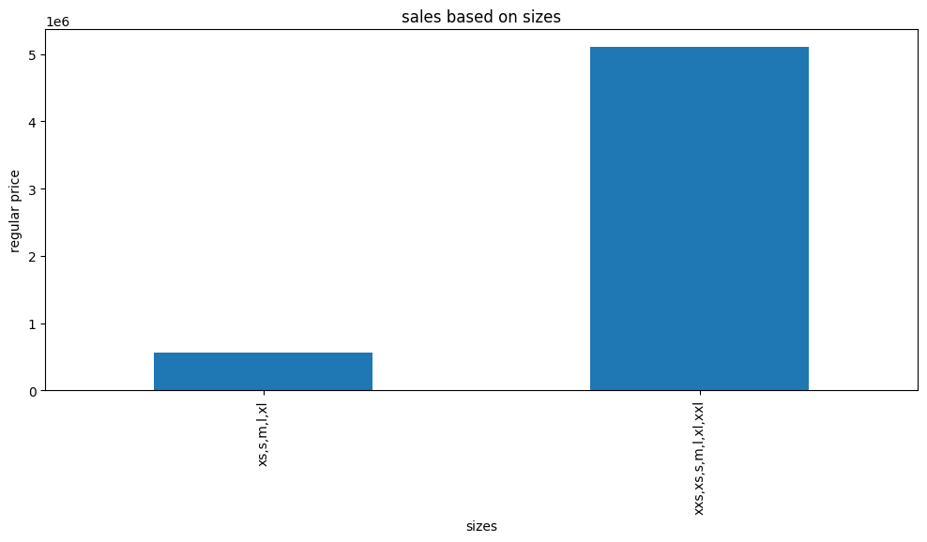
Sizes Insights
The variety of sizes affects the purchase rate.
There's a positive correlation between the variety of sizes and the selling rate.

Slide 8
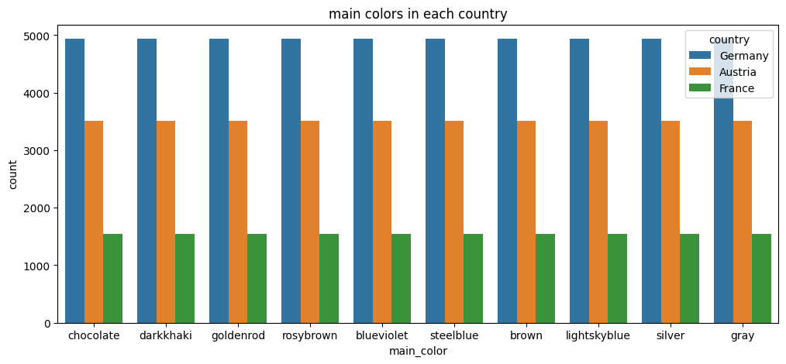
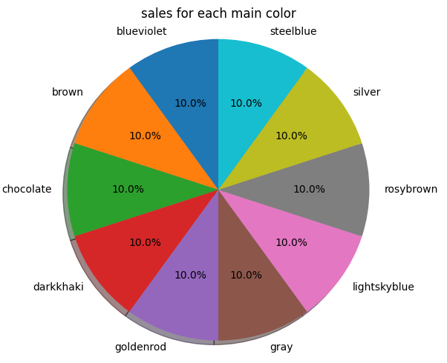
Main Color Insights
All main colors are equally distributed among the three countries in the campaign
All main colors have the same purchase rate

Slide 9
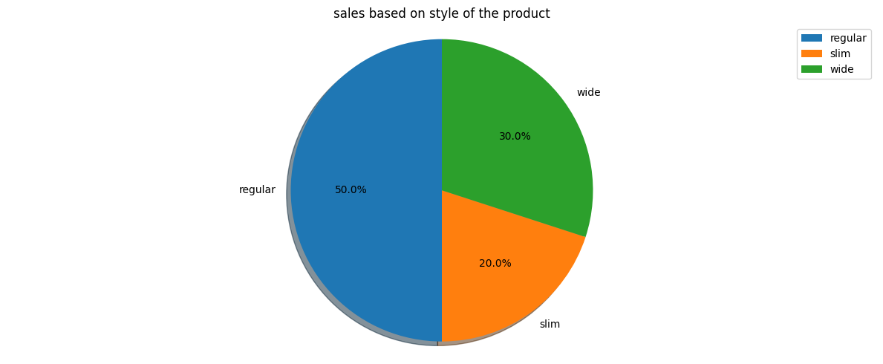
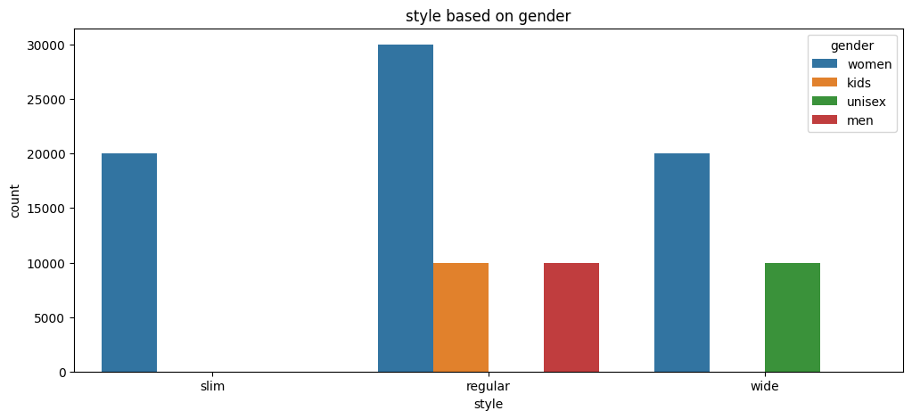
Secondary Color Insights
Regular style has the highest purchase rate.
Unisex group only interested in wide style.
Men and kids are only interested in regular style.
Women is the only interested gender in slim style.
Women show interest in every style specially the regular one.

Slide 10
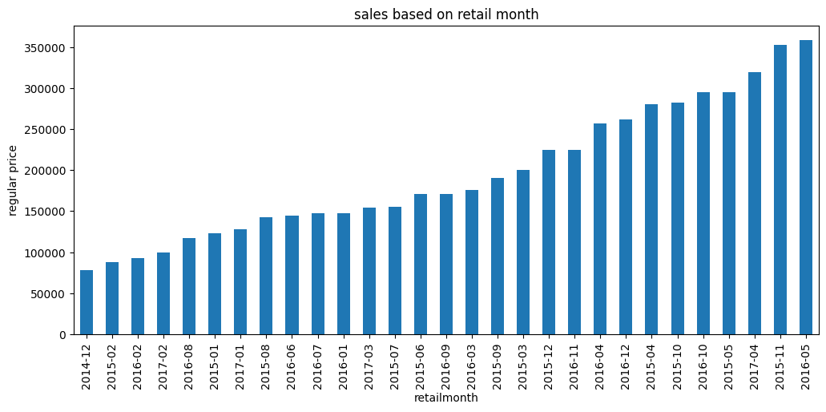
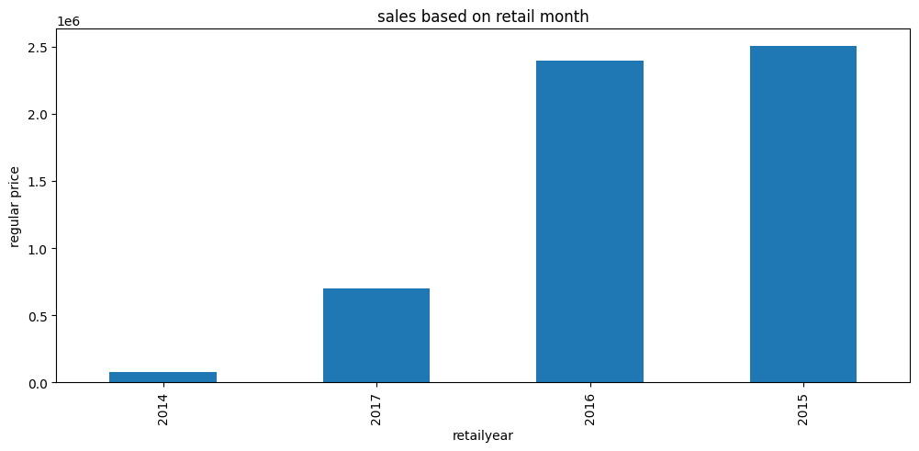
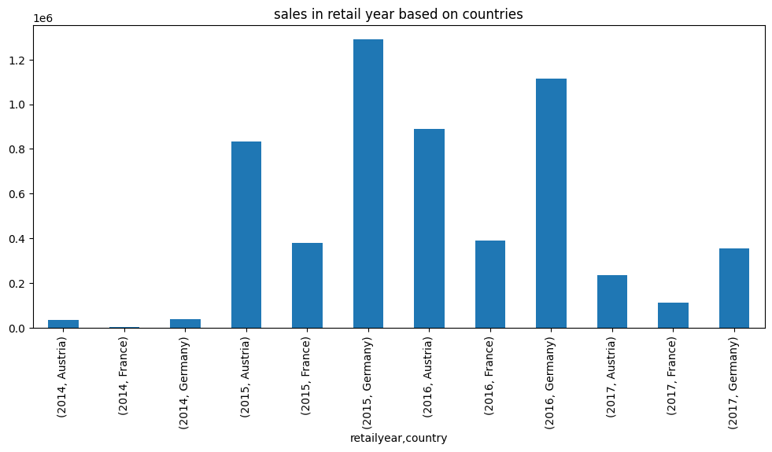
Retail[w, m, y] Insights
the highest purchase rate in May 2016 and November 2015
THE lowest purchase rate in December 2014
February has low purchase rate among all the presented years.
2014 has the lowest purchase rate, 2017 comes after it.
Purchase rate at its peak in 2015
Purchase rate is slightly lower in 2016 than in 2015.
Germany highest purchase rate was in 2015.
Austria highest purchase rate was in 2016.
France highest purchase rate was in 2016 and almost the same in 2015.

Slide 11
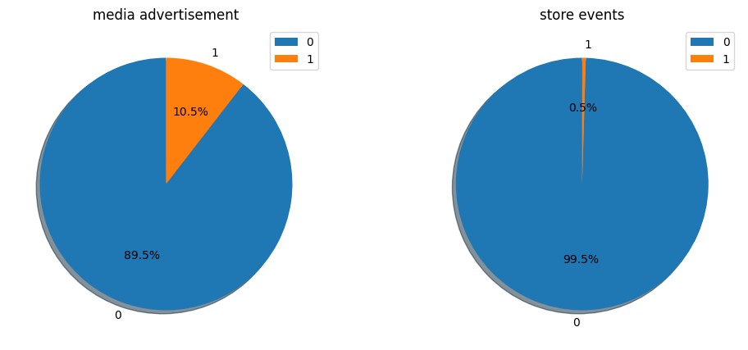
Promotions Insights
Sales during media advertisement is low with a percentage of 10.5%.
Sales rate during store events is extremely low 0.5%

